Slide 1
Case Study for Hardwired and Micro programmed Control Units (JC-62)

Slide 2
The Basic Computer
all traditional digital computers have two principal functional parts
the data path section in which processing occurs
the control section which is responsible for decoding instructions and leaving the correct sequence of control signals to make the processing happen in the data path.

Slide 3
Basically there are two types of control units:
hard-wired controllers
micro-programmed controller

Slide 4
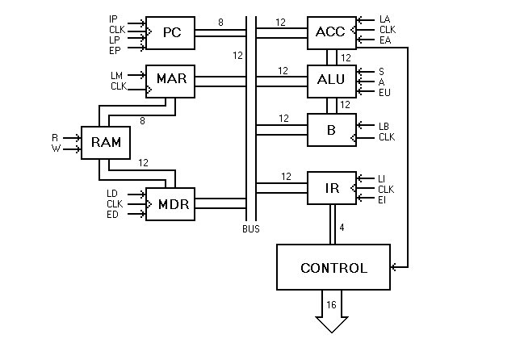
D

Slide 5
Data Bus: 12- bits (Data paths)
Address bus: 8-bits
Memory Size: 256×12
Word size/word length: 12-bit
Control signals: 16
The registers and the 256 X 12 bit RAM memory are controlled by 16 control signals
Most of the registers have Load (L) and Enabled (E) signals.
An active L signal to a register causes the contents of the bus to be clocked into that register on the next rising pulse from the system clock. (Bus-> register)
An active E signal enables the tri-state outputs of the register, thereby making its contents available to the bus. (register->bus)
e.g. A->B, EA of A and LB of B

Slide 6
Processing of data is done by the Arithmetic-Logic-Unit (ALU), a circuit that is capable of adding or subtracting the 12-bit numbers contained in its two input registers: the accumulator (ACC) and register B.
ACC operation B->ACC
The operation performed by the ALU is selected by the Add (A) or Subtract (S) control signals.
The accumulator also contains a single flip-flop that is set whenever its contents are negative.
The value of this "negative flag" provides input to the controller/sequencer, and permits implementation of conditional branching instructions.

Slide 7
The Computer's Instruction Set
An instruction on computer consists of one 12-bit word.
The leading four bits form the operation code (opcode) which specifies the action to be taken, and the remaining 8 bits, when used, indicate the memory address of one of the instruction's operands.
instructions that have two operands, the other operand is always contained within the accumulator.
Opcode (4-bit) | Operand (memory Address) (8-bit)

Slide 8
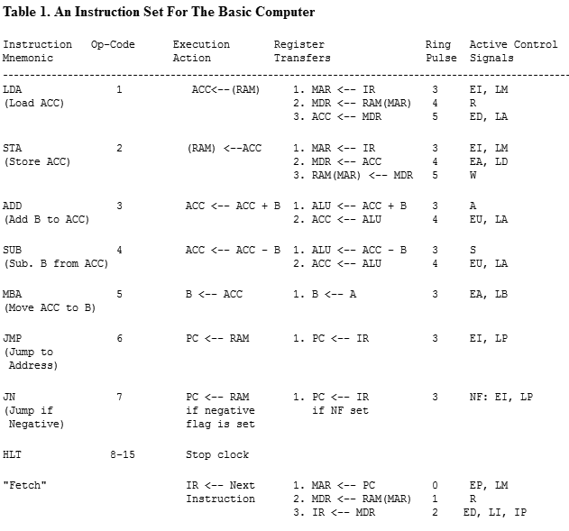
The Computer's Instruction Set

Slide 9
The Hard-Wired Control Unit
Input to the controller consists of the 4-bit opcode of the instruction currently contained in the Instruction Register and the negative flag from the accumulator.
The controller's output is a set of 16 control signals that go out to the various registers and to the memory of the computer.
HLT signal that is activated whenever the leading bit of the op-code is one.
The controller is composed of the following functional units:
A ring counter, an instruction decoder, and a control matrix.

Slide 10
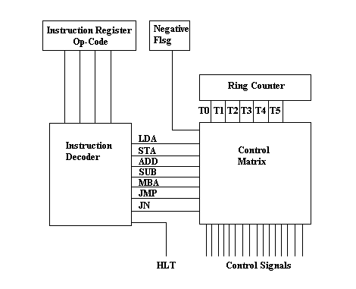
The Hard-Wired Control Unit

Slide 11
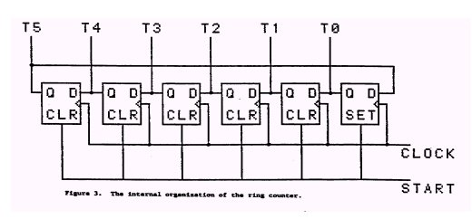
Ring counter
The ring counter provides a sequence of six consecutive active signals that cycle continuously.

Slide 12
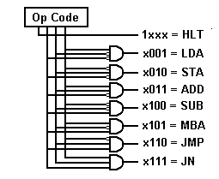
Decoder
Bubble means’0’
Without bubble means ‘1’

Slide 13
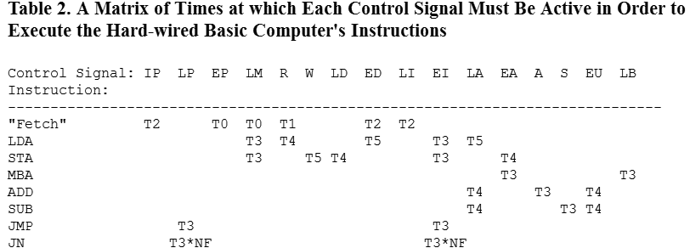

Slide 14
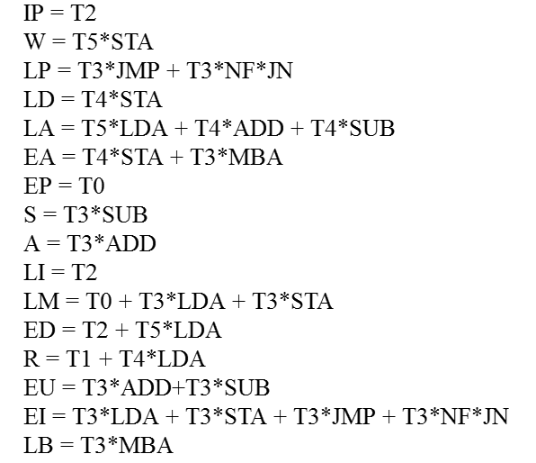
Figure 6. The logical equations required for each of the hardwired control signals on the basic computer. The machine's control matrix is designed from these equations.

Slide 15
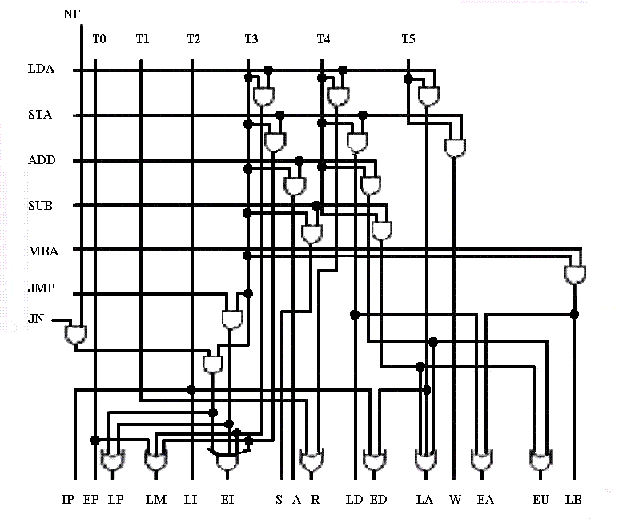

Slide 16
A Micro-programmed Control Unit
the controller causes instructions to be executed by issuing a specific set of control signals at each beat of the system clock.
Each set of control signals issued causes one basic operation (micro-operation)
sets of control signals that cause specific micro-operations to occur as being "microinstructions" that could be stored in a memory.
Each bit of a microinstruction might correspond to one control signal.
If the bit is set it means that the control signal will be active; if cleared the signal will be inactive.
Sequences of microinstructions could be stored in an internal "control" memory.
A sequence of microinstructions that implements an instruction on the external computer is known as a micro-routine.
The instruction set of the computer is thus determined by the set of micro-routines, the "microprogram," stored in the controller's memory.
The control unit of a microprogram-controlled computer is essentially a computer within a computer.

Slide 17
IP, LP, EP, LM, R, W, LD, ED, LI, EI, LA, EA, A, S, EU, LB
Fetch operation (Control bits)
3000h
0800h
8180h
LDA
1040
0800
0120

Slide 18
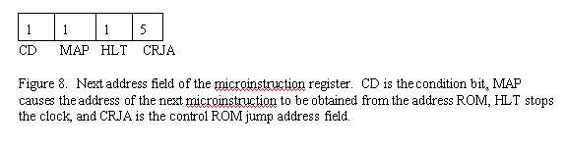
Micro- Instruction(Control Word)
Control Word (16-bit) | CD (1-bit) | MAP (1-bit) | HLT (1-bit) | CRJA (5-bit)
24-bit

Slide 19
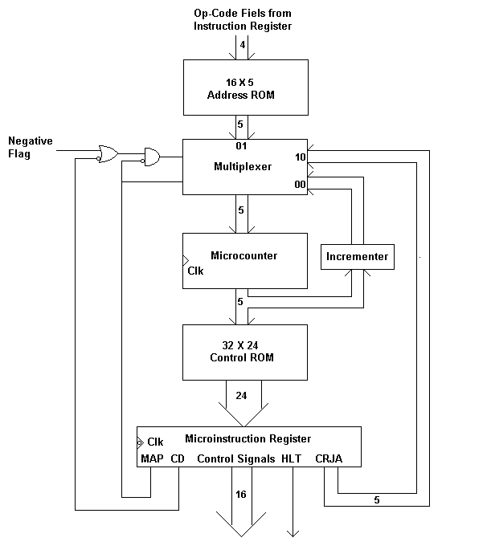
A Microprogrammed Control Unit for the Simple Computer
or Micro PC
or Micro IR

Slide 20
Control ROM
Addresses provided to the control ROM come from a micro-counter register, which is analogous to the external machine's program counter.
The micro-counter, in turn, receives its input from a multiplexer which selects from :
(1) the output of an address ROM,
(2) a current-address incrementer, or
(3) the address stored in the next-address field of the current microinstruction.

Slide 21
Address ROM
Address zero of the address ROM contains the control-ROM address of the fetch routine; each other addresses in the address-ROM corresponds to one of the op-codes of the computer's instruction set.

Slide 22
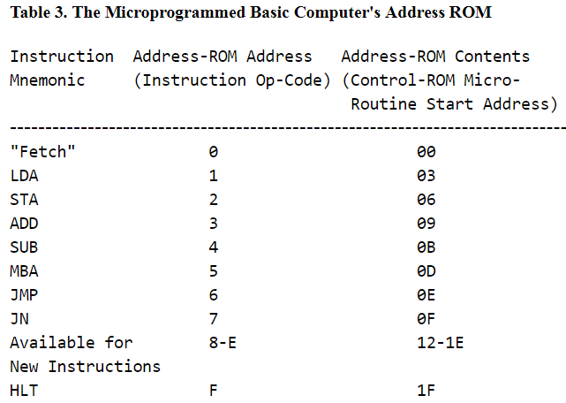
Address ROM

Slide 23
MAP=1:Bring address from IR (Select code 01)
MAP=0 & CD=0:Unconditional Branch (Select logic 10) Take CRJA as next address
MAP=0 & CD=1 :Conditional Branch
Select logic =00 (if NF=0) load inc. address , no branching
Select logic =10 (if NF=1) use CRJA for next micro-instruction, Branching
MAP | CD | Select Logic
0 | 0 | 1 | 0 | Unconditional Branch, Take CRJA as next address
0 | 1 | 0 | 0 | If NF=0, Load Incrementer address, No branching
 |  | 1 | 0 | If NF=1, use CRJA for next Micro-instruction, Branching
1 | X | 0 | 1 | Bring Address from IR/ Address ROM

Slide 24
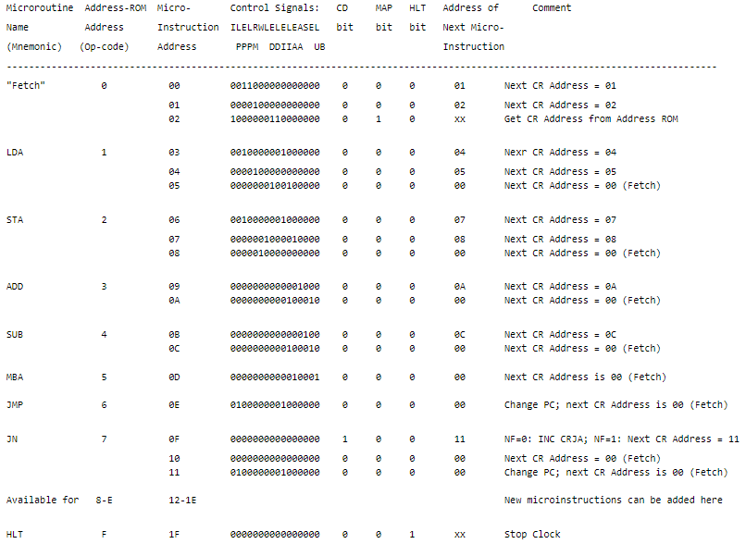
Table 4. The Microprogram that Implements the Basic Computer's Instruction Set

Slide 25
Example:
LABEL_Z : ADD
SUB
JN LABEL_Z
MBA

Slide 26
Hardwired vs. Micro-programmed Computers
micro-programmed
Flexibility
Simplified
Hardwired
Fast

